Slide 1

Notes:
Introduction (3 mins)
Slide 1
Welcome your parents to the Relationship and Health Education parent session.
In this brief introduction, explain:
What your school is doing (implementing a new Catholic ethos Relationship and Health Education programme that meets the government’s new statutory RSE guidelines)
Why your school is choosing to use the programme (e.g. recommended by the diocese/another school, to meet criteria for statutory RSE, growing partnership with Ten Ten Resources etc.)
Who Ten Ten Resources is (an award-winning theatre, film and educational organisation working in Catholic primary and secondary schools throughout the UK
When the programme will be rolled out in school

Slide 2
RSHE – Relationships, Sex and Health Education
Today’s children and young people are growing up in an increasingly complex world and living their lives seamlessly on and offline. This presents many positive and exciting opportunities, but also challenges and risks. In this environment, children and young people need to know how to be safe and healthy, and how to manage their academic, personal and social lives in a positive way. This is why Relationships Education is compulsory in all primary schools in England.

Slide 3
RSHE Curriculum
The national curriculum for RSHE was made statutory in 2019. The link for this is below. You can also visit The Priory website where Mrs Grimes, who leads the RSHE, has put on our school policy and further information. https://assets.publishing.service.gov.uk/government/uploads/system/uploads/attachment_data/file/1019542/Relationships_Education__Relationships_and_Sex_Education__RSE__and_Health_Education.pdf
To deliver this within school, we are using a Catholic scheme called Ten:Ten

Slide 4
Inclusivity and right to withdraw
Pupils will be taught the facts about all topics we cover in an age-appropriate and inclusive way. Should we feel something may not be appropriate or that it needs to be taught in a different way we will tailor the programme in such a way to meet the needs of individual children.
The RHE elements of the curriculum is compulsory, however parents do have the right to request that your child is withdrawn from some or all of the sex education delivered. Should you want to do this please contact me via dojo where I get organise a meeting to then discuss this with you further.

Slide 5
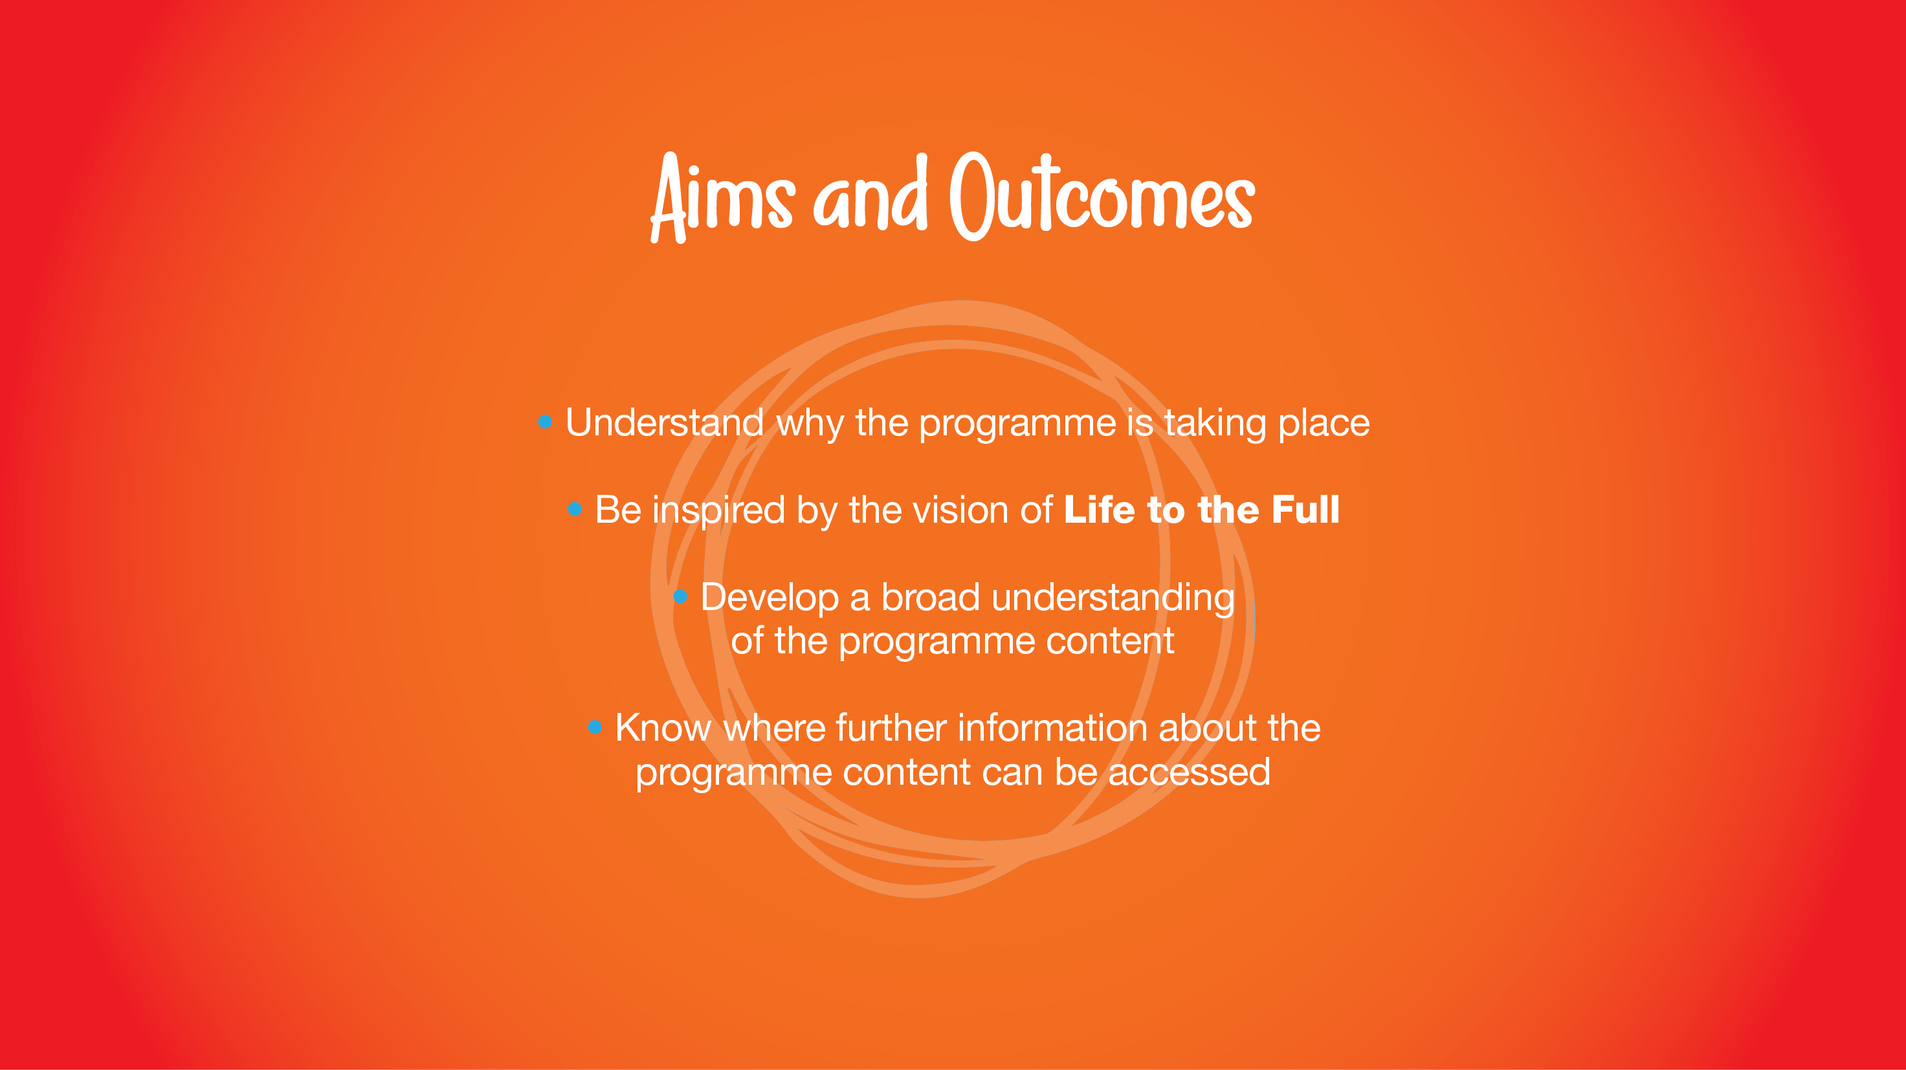
Notes:
Slide 2
Outline what you are going to cover in this session and tell parents how long you expect the session to last.
Aims and outcomes
Parents will:
Understand why the programme is taking place;
Be inspired by the vision of Life to the Full;
Develop a broad understanding of the programme content;
Know where further information about the programme content can be accessed.
[Optional] Contribute to Key Decisions about the programme content
NB. The line about contributing to Key Decisions has been omitted from the list on Slide 2; however, it has been added as an additional slide at the end of the presentation (Slide 28) which you can use instead of this slide.

Slide 6


Notes:
Vision Film (12 mins)
Slide 3
To begin, watch together the Vision of Life to the Full, a 12-minute video made by Ten Ten Resources. This film briefly outlines:
The Catholic vision of the human person;
How this relates to Relationship and Health Education in schools; and
The inclusive and pastoral nature of the programme.
Play: Vision Film
https://www.tentenresources.co.uk/videos/the-vision/

Slide 7

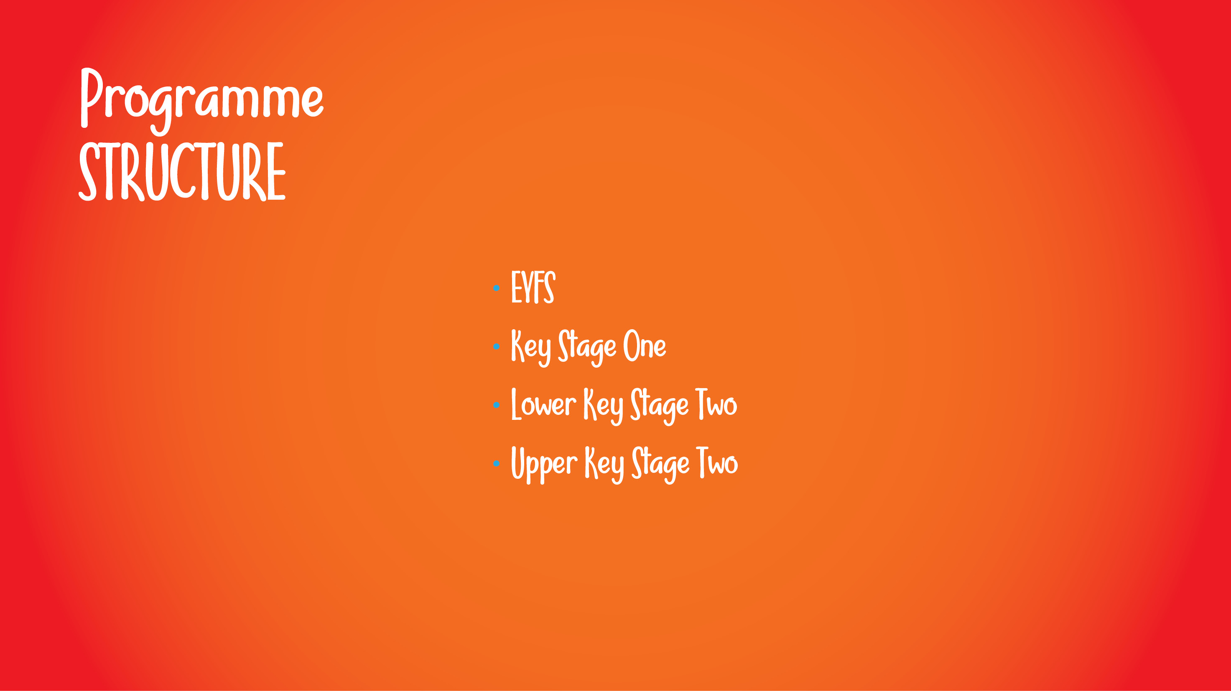
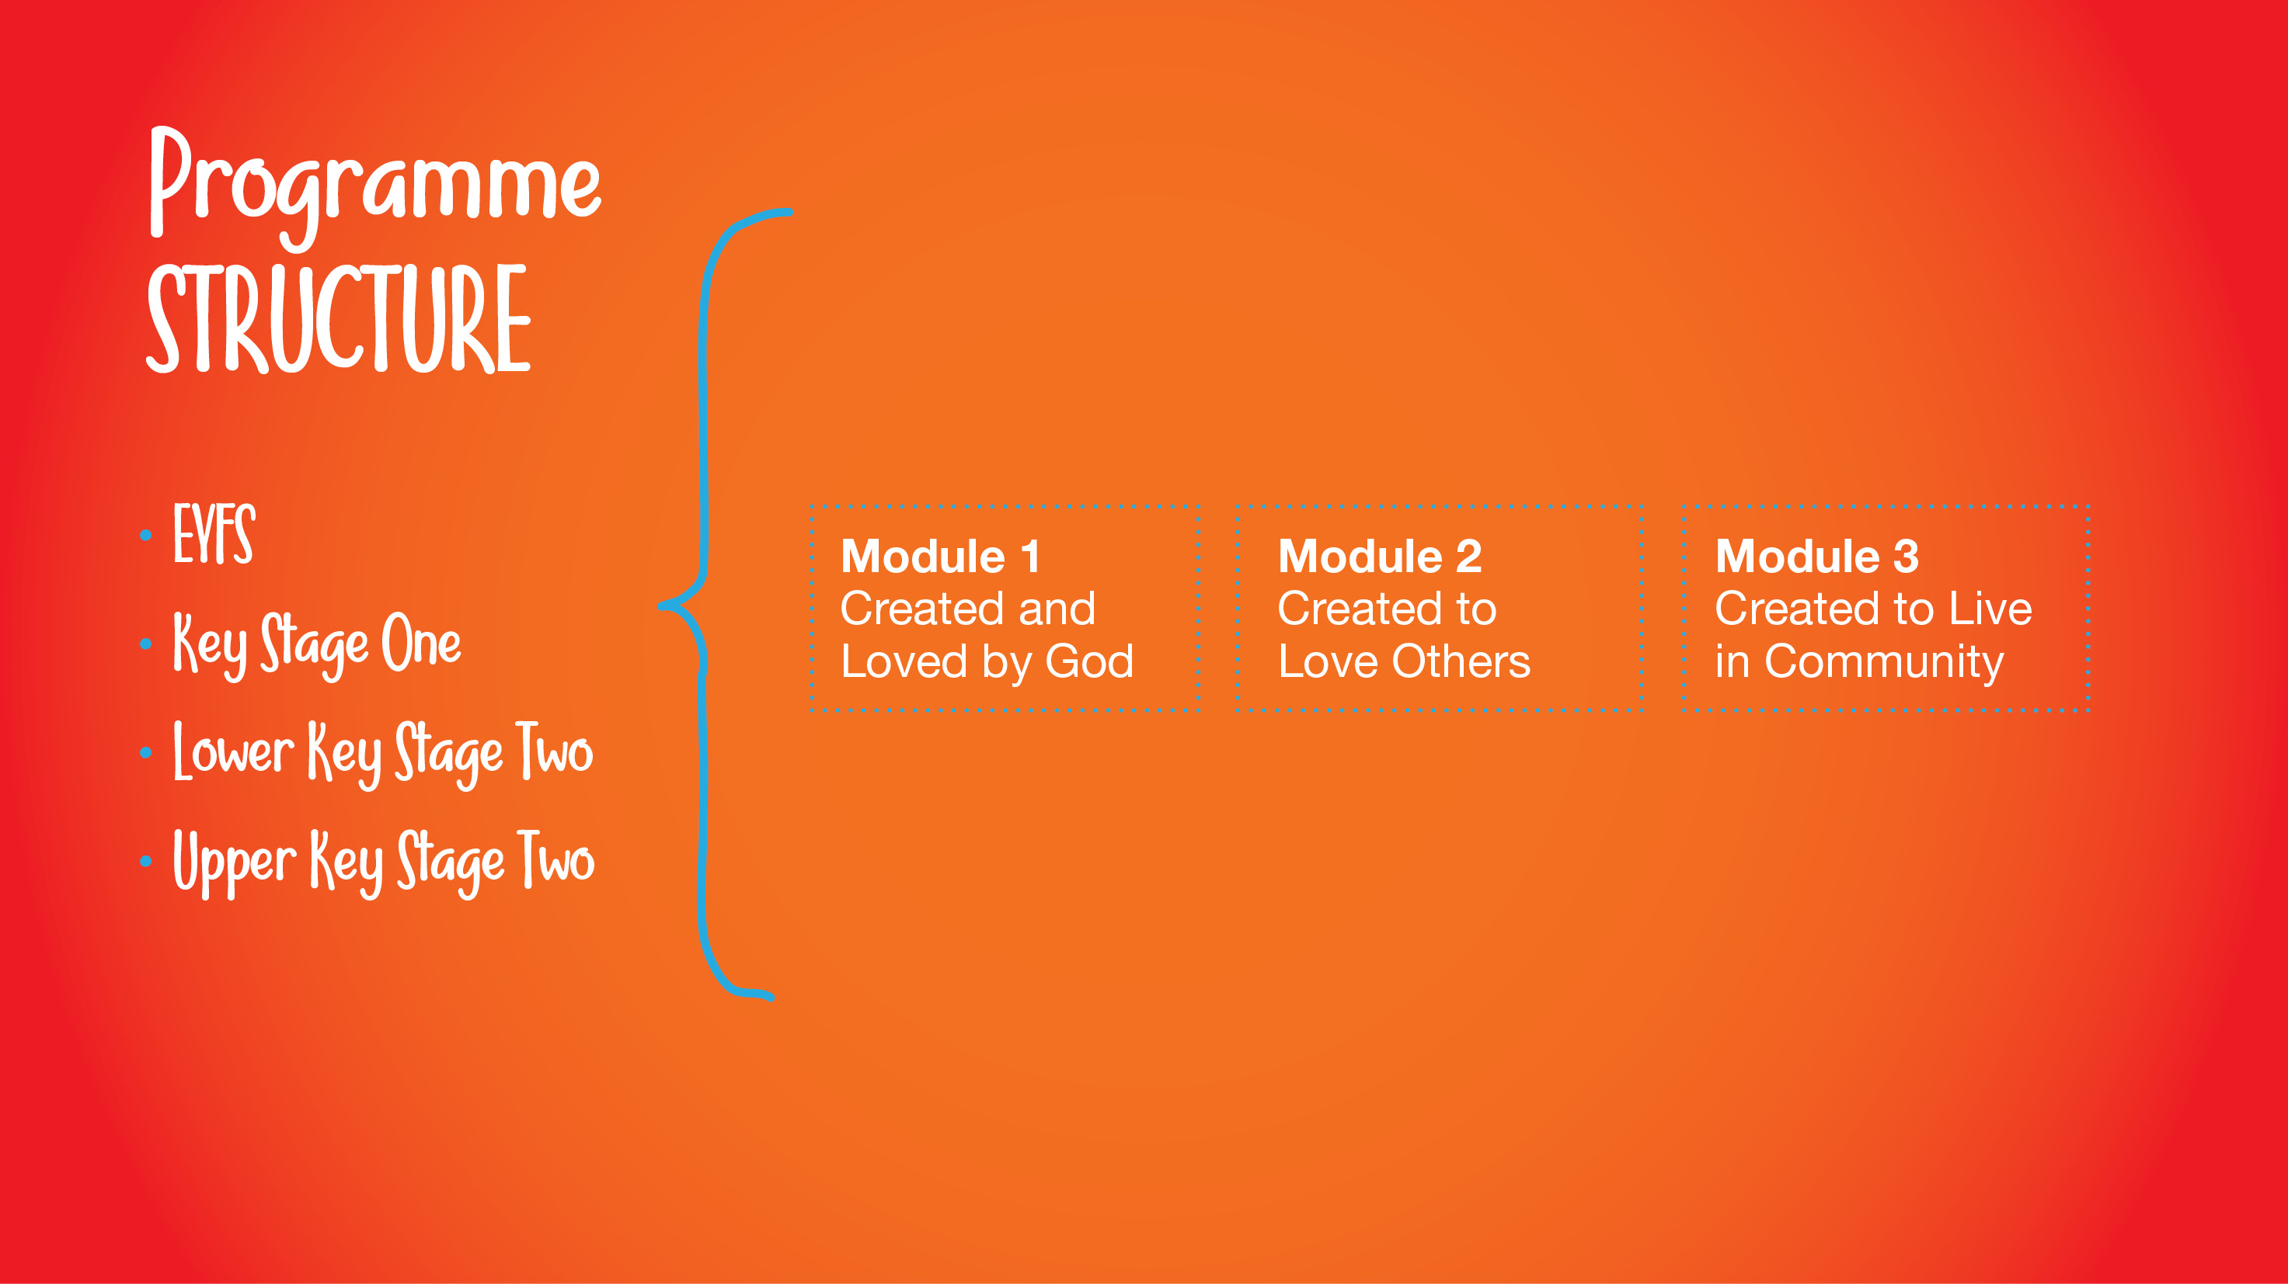
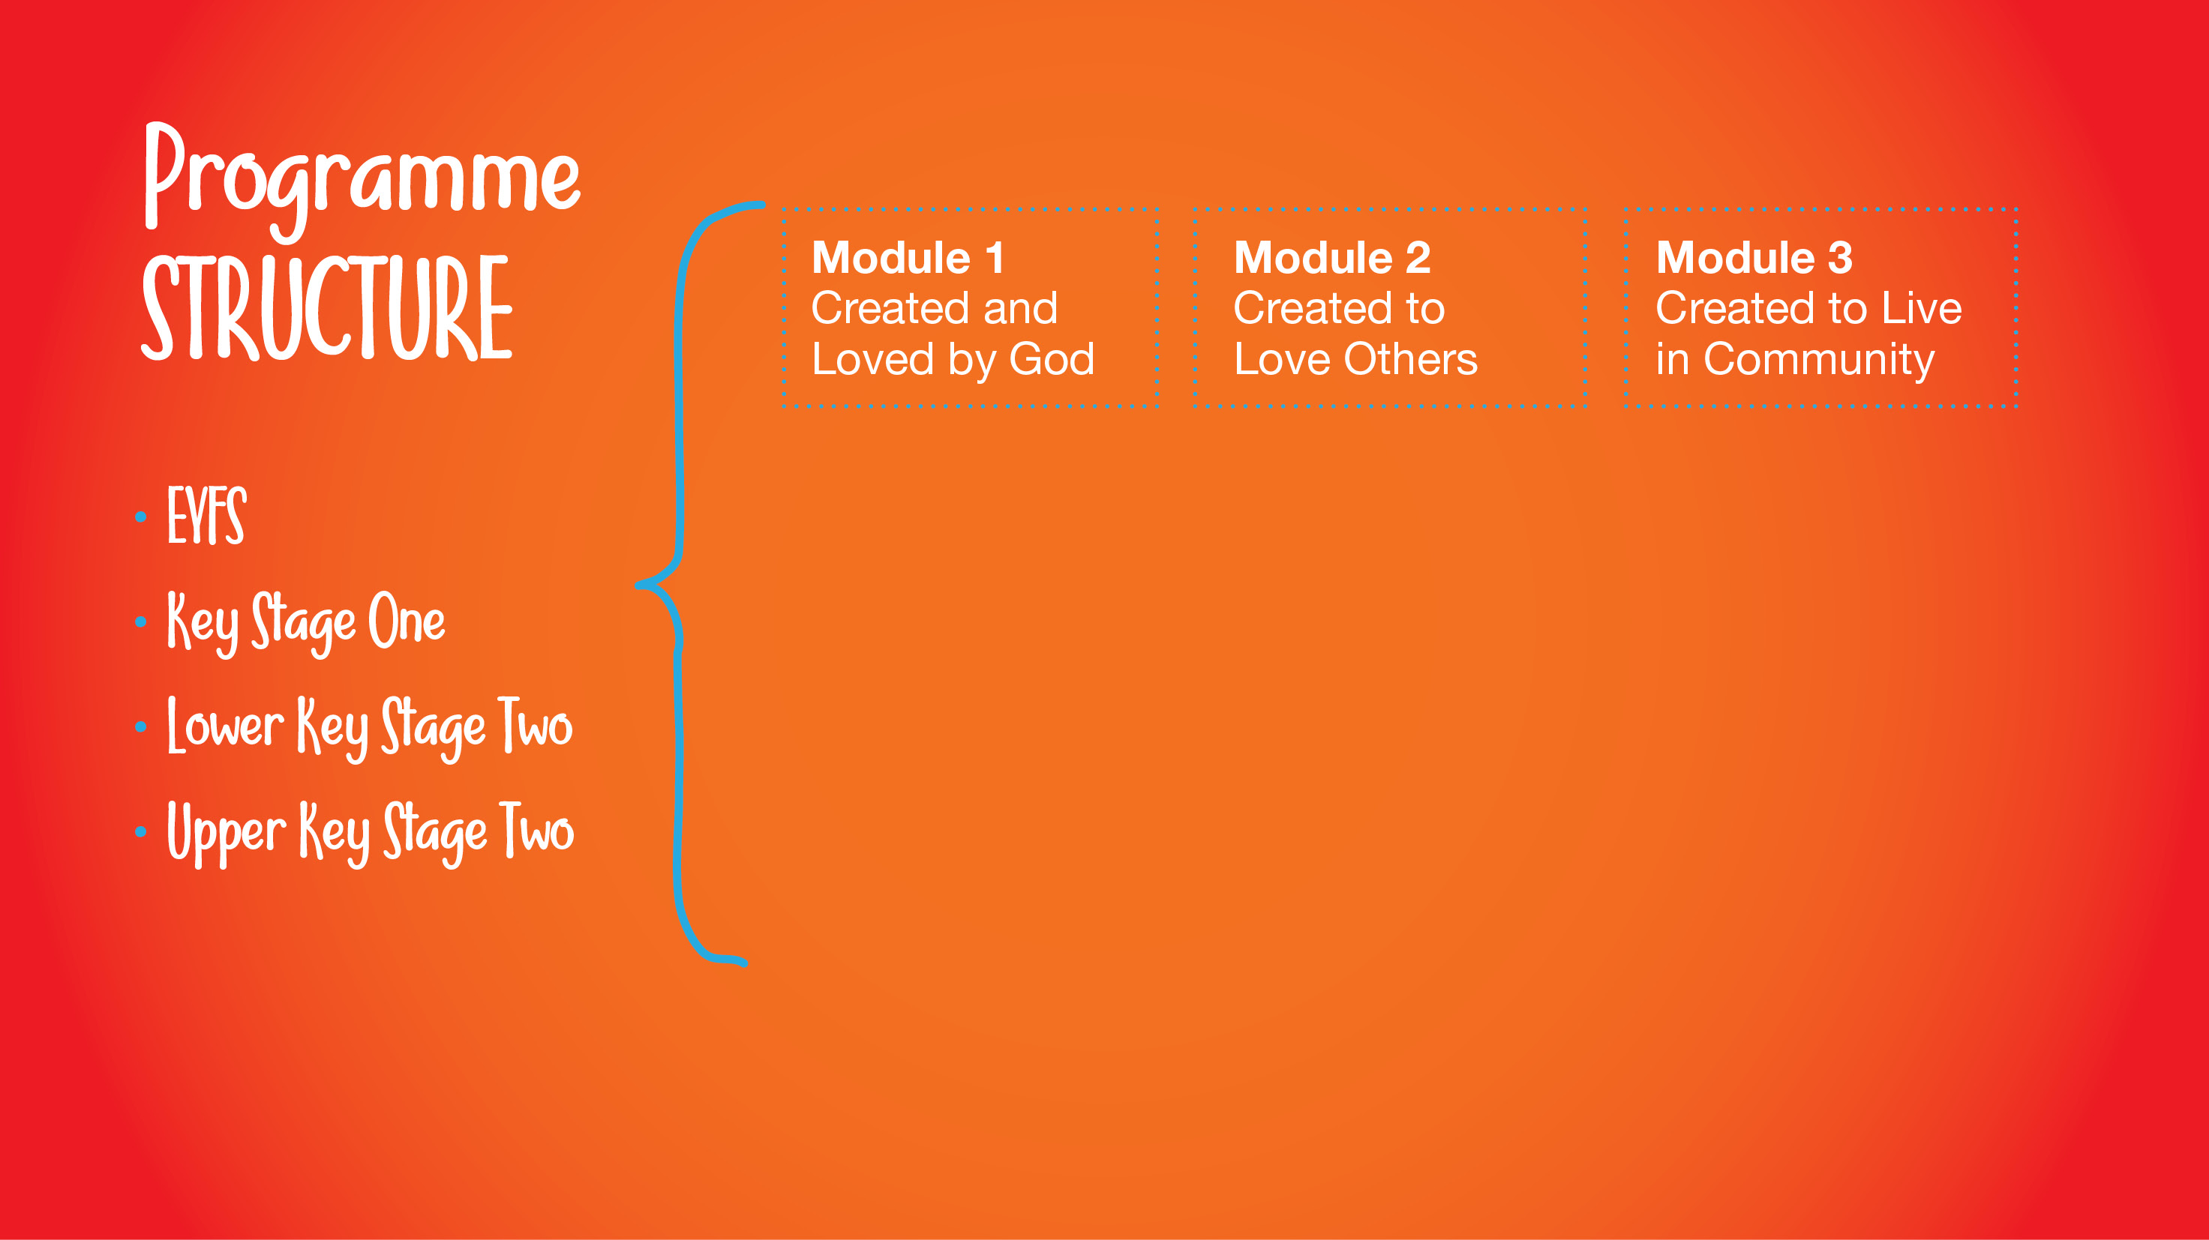
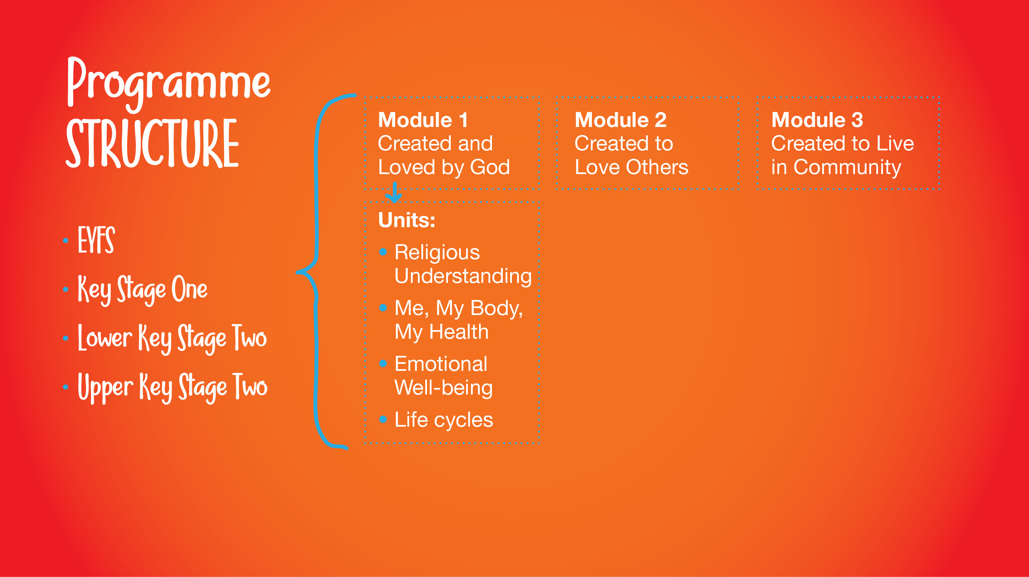
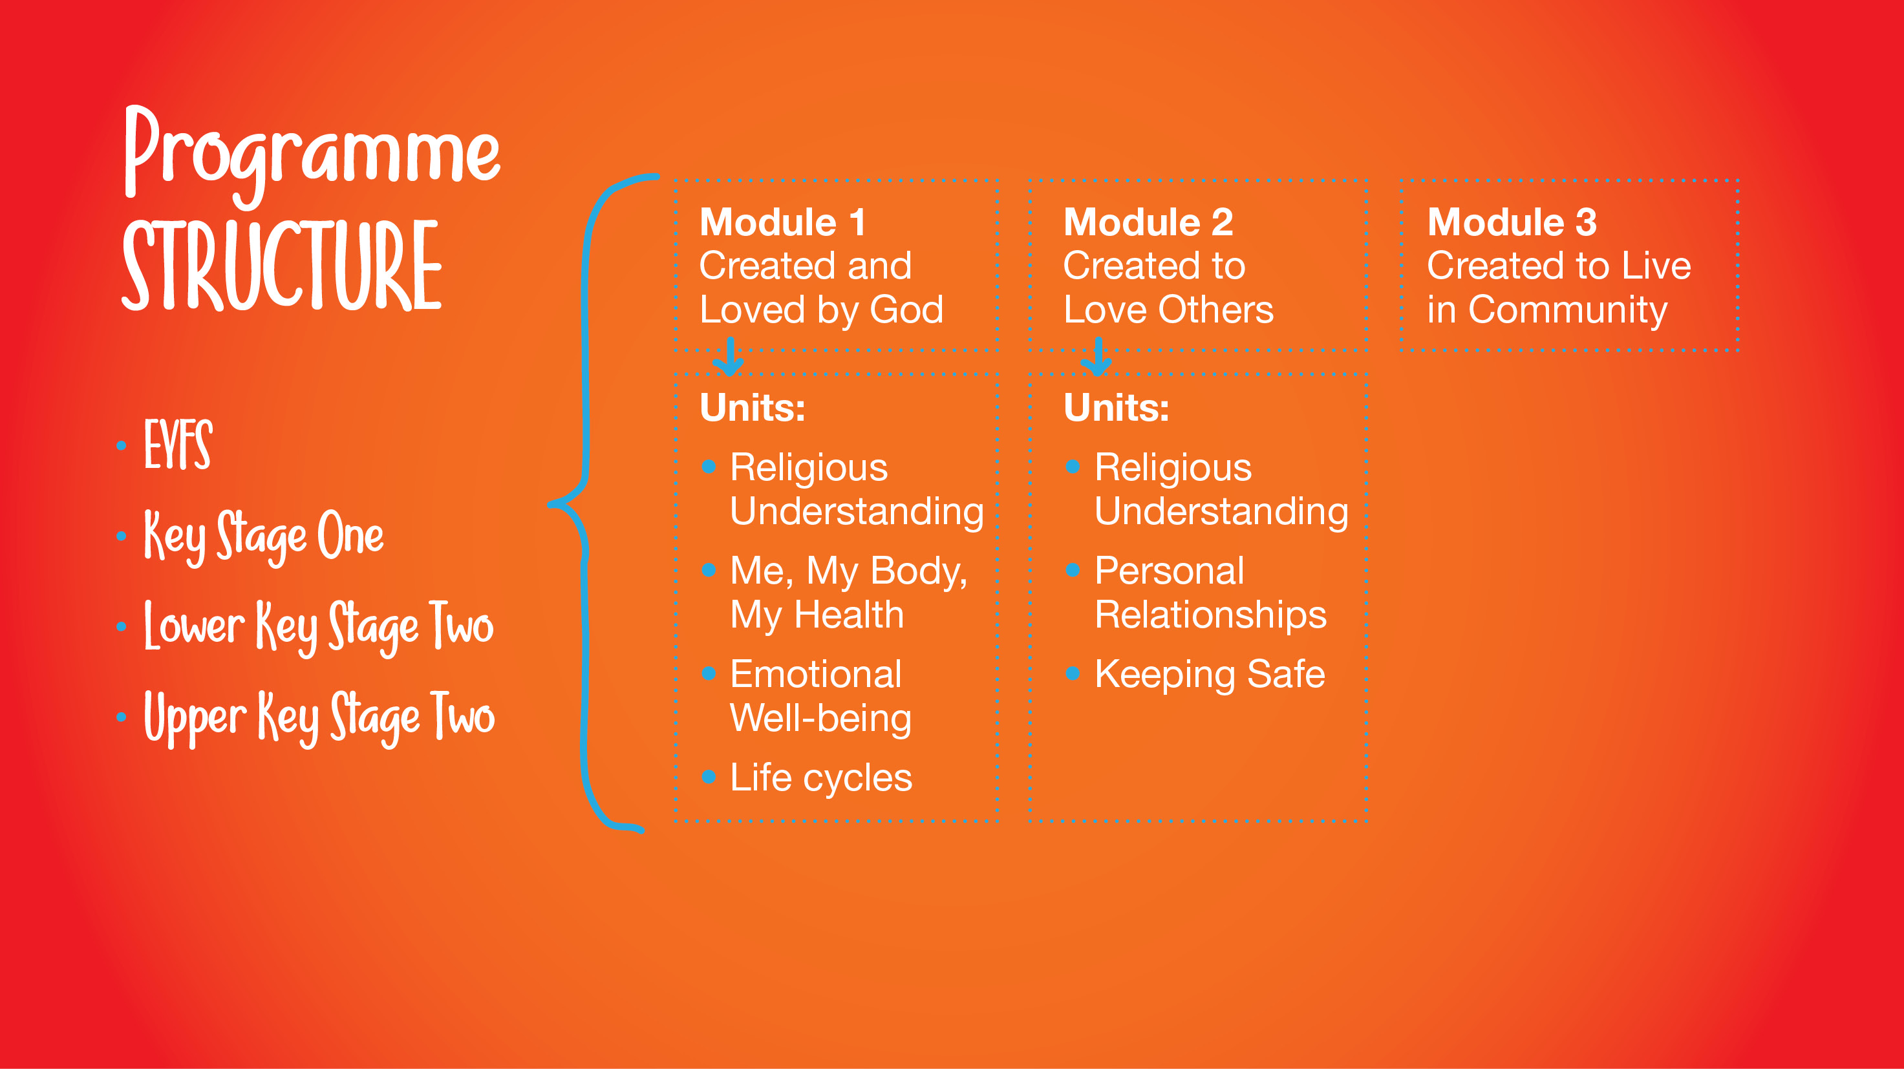
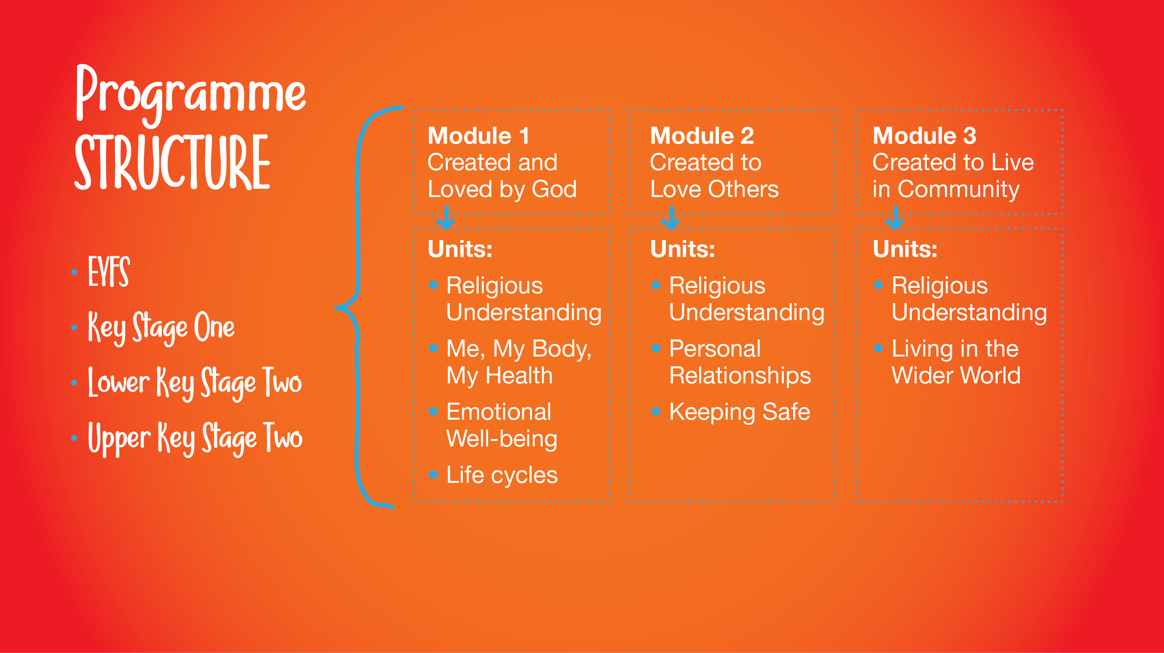
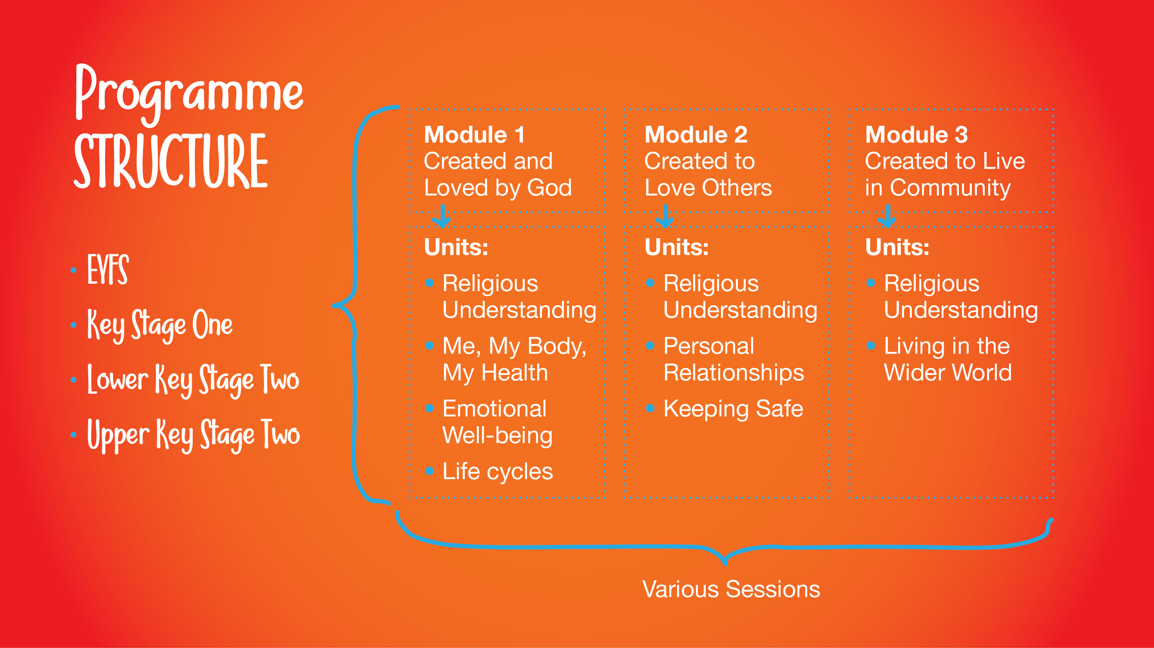
Notes:
Programme Content (3 mins)
Slide 4
Handout a copy of Appendix One: A5 Booklet to every parent.
Using the booklets and slides for reference, provide a brief overview of the programme structure.
Learning Stages
Explain that the programme adopts a spiral curriculum taught across 3 learning stages. Click to reveal the 3 learning stages and explain the year groups they relate to:
Early Years Foundation Stage is aimed at Preschool and Reception
Key Stage One is aimed at Years 1 and 2
Lower Key Stage Two is aimed at Years 3 and 4
Upper Key Stage Two is aimed at Years 5 and 6
Modules
Explain that each learning stage covers the same 3 modules. Click to reveal the titles of the 3 modules:
Created and Loved by God
Created to Love Others
Created to Live in Community
We will discuss these in more detail later.
Units
Explain that each module also covers the same Unit topics across each learning stage. Click to reveal the titles of the Units within each Module:
Module 1 Units
Religious Understanding
Me, my body, my health
Emotional well-being
Life cycles
Module 2 Units
Religious Understanding
Personal Relationships
Life Online
Keeping Safe
Module 3 Units
Religious Understanding
Living in the Wider World
Lessons
Finally, click reveal the term ‘Various lessons and sessions’ to explain that each unit contains a number of lessons and sessions to be led in the classroom.

Slide 8
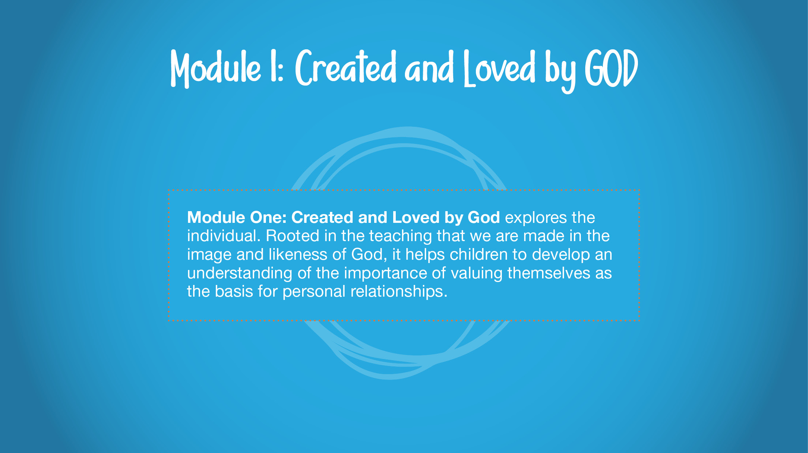
Notes:
Module One in detail (5 mins)
Slide 5
Module One: Created and Loved by God
Using the text on screen, explain that Module One: Created and Loved by God explores the individual. Rooted in the teaching that we are made in the image and likeness of God, it helps children to develop an understanding of the importance of valuing themselves as the basis for personal relationships.

Slide 9
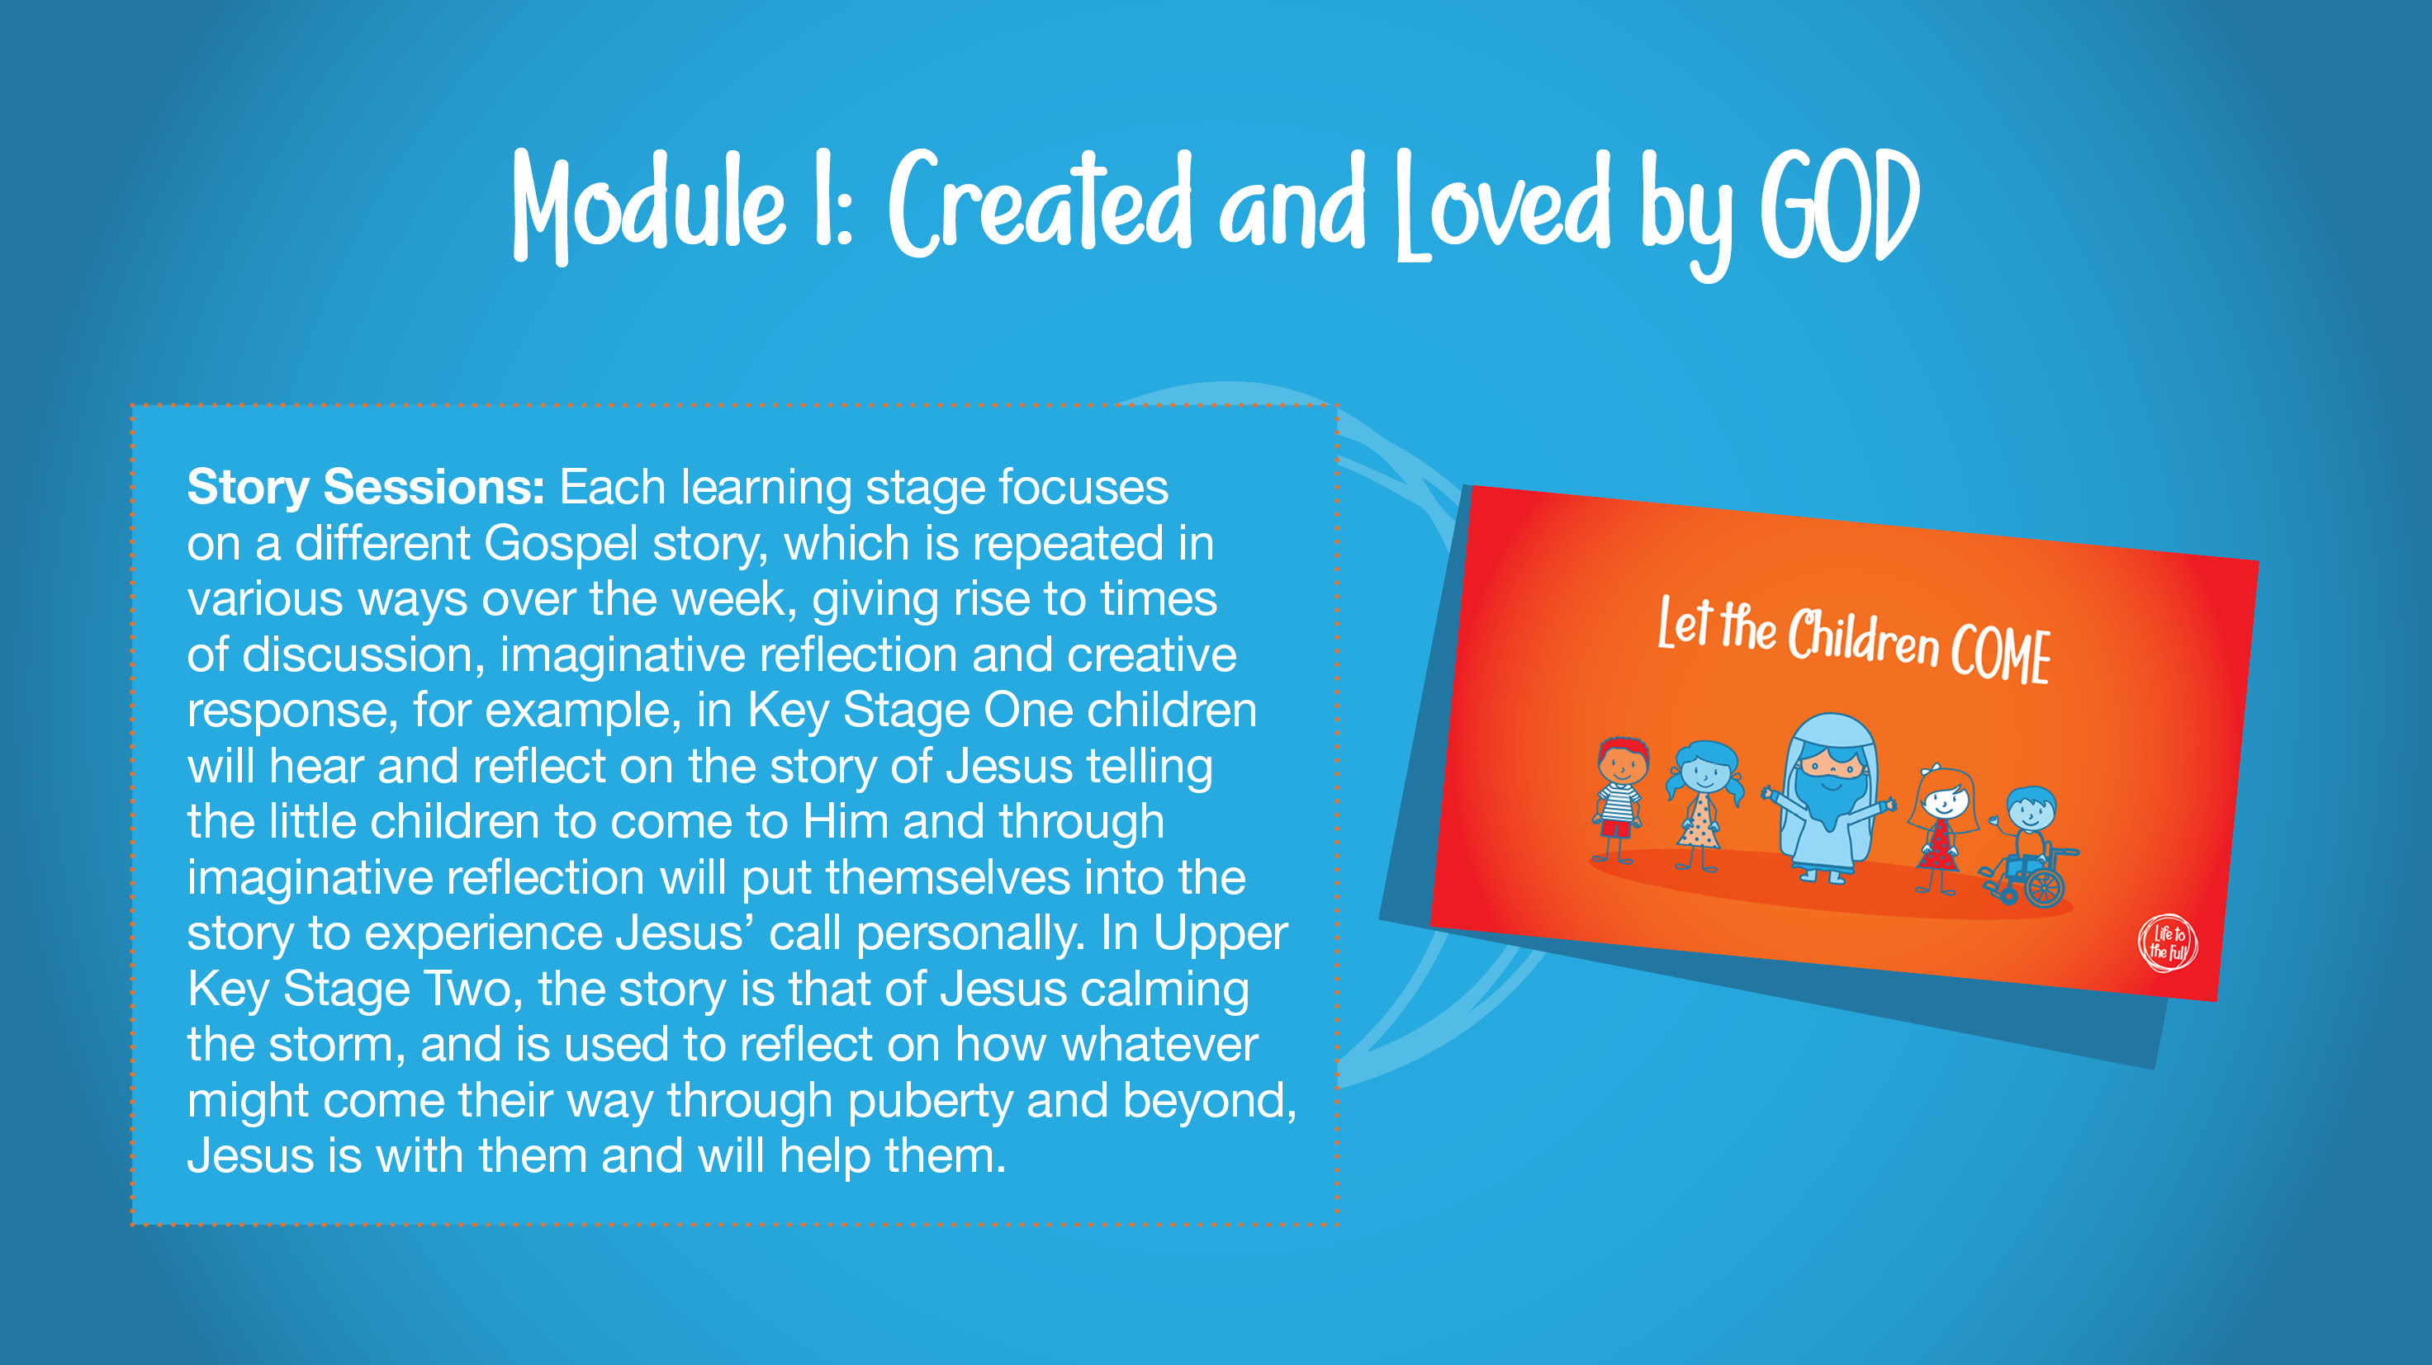
Notes:
Slide 6
Explain that at the start of each learning stage in Module 1, are a series of short Story Sessions to be completed on consecutive days throughout the week. Invite parents to spend a few moments quietly reading the text on screen which describes these story sessions: Each learning stage focuses on a different Gospel story, which is repeated in various ways over the week, giving rise to times of discussion, imaginative reflection and creative response, for example, in Key Stage One children will hear and reflect on the story of Jesus telling the little children to come to Him and through imaginative reflection will put themselves into the story to experience Jesus’ call personally. In Upper Key Stage Two, the story is that of Jesus calming the storm, and is used to reflect on how whatever might come their way through puberty and beyond, Jesus is with them and will help them.

Slide 10
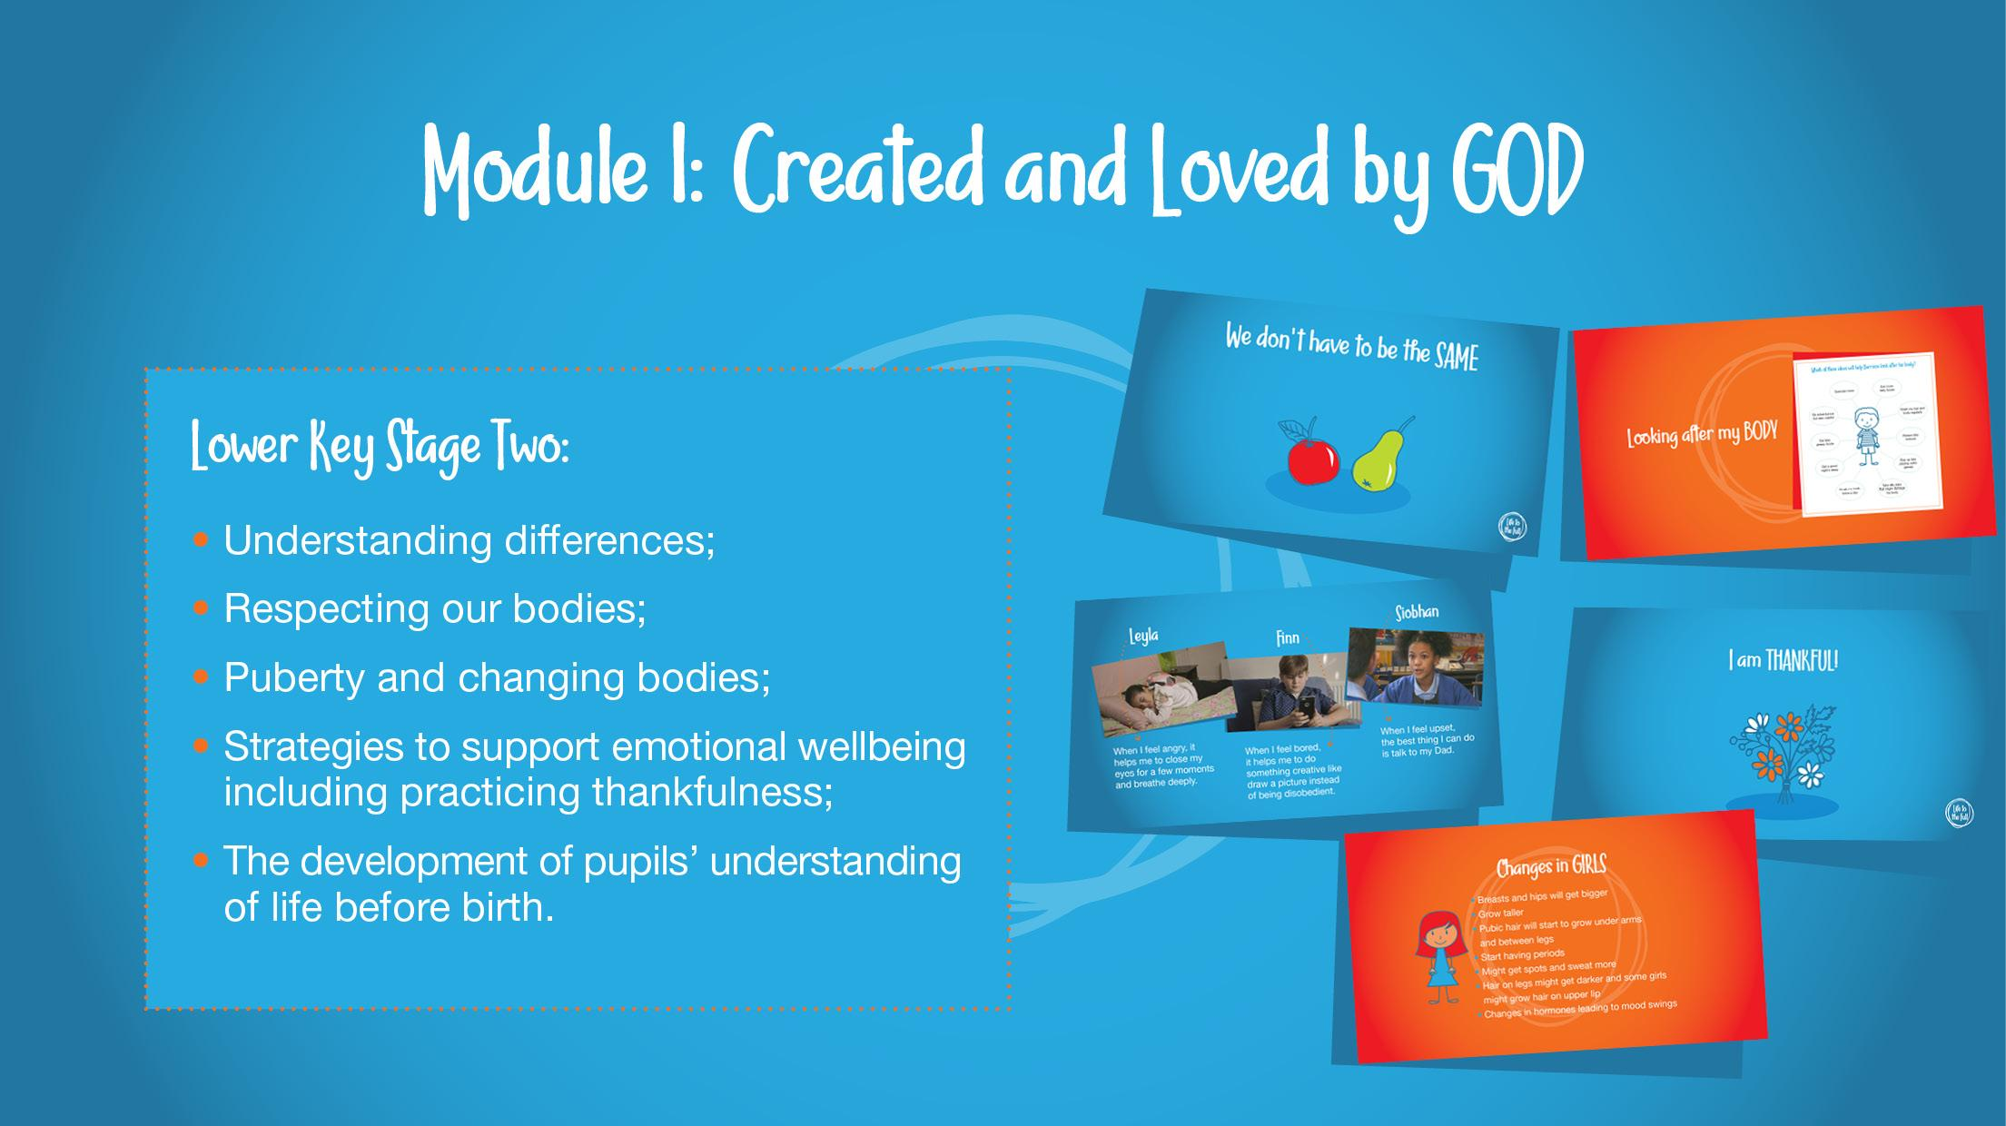

Notes:
Slide 9
Lower Key Stage Two – understanding differences, respecting our bodies, puberty and changing bodies**, strategies to support emotional wellbeing including practising thankfulness, and the development of pupils' understanding of life before birth.

Slide 11
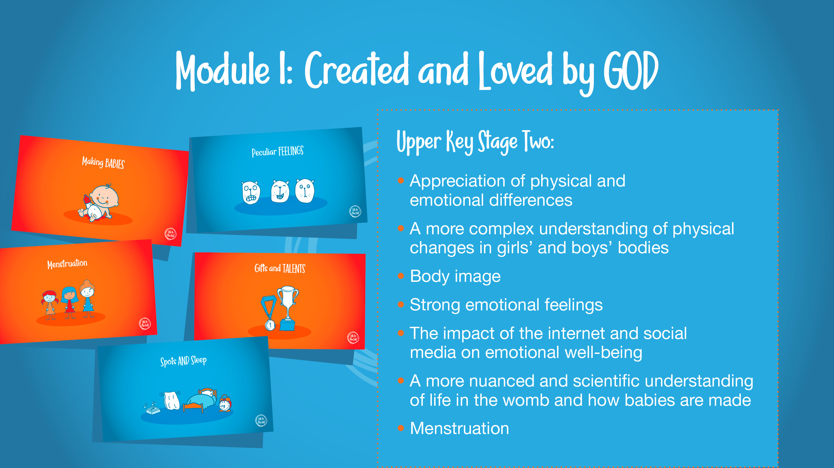
Notes:
Slide 10
Upper Key Stage Two – appreciation of physical and emotional differences, a more complex understanding of physical changes in girl and boys bodies, body image, strong emotional feelings, the impact of the internet and social media on emotional well-being, a more nuanced and scientific understanding of life in the womb and how babies are made**, and menstruation.
As Session Leader, to familiarise yourself with the information regarding Key Decisions concerning genitalia (KS1), puberty (LKS2), pornography (UKS2) and sexual intimacy (UKS2) and more. You have the option to discuss these Key Decisions with parents later in this session.

Slide 12
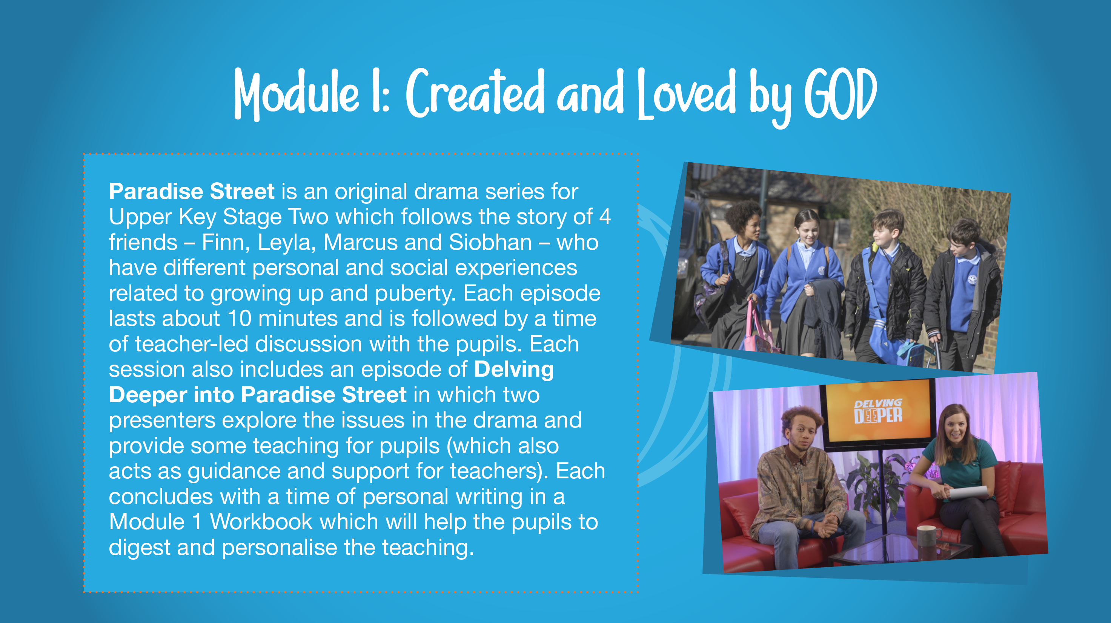
Notes:
Slide 11
Explain that there are 11 sessions in Module 1 of Upper Key Stage Two which are structured around an original drama series by Ten Ten called Paradise Street.
Invite staff to quietly read the text on screen for a moment or two. It says:
Paradise Street is an original drama series for Upper Key Stage Two which follows the story of 4 friends – Finn, Leyla, Marcus and Siobhan – who have different personal and social experiences related to growing up and puberty. Each episode lasts about 10 minutes and is followed by a time of teacher-led discussion with the pupils. Each session also includes an episode of “Delving Deeper into Paradise Street” in which two fun presenters explore the issues in the drama and provide some teaching for pupils (which also acts as guidance and support for teachers). Each concludes with a time of personal writing in a Module 1 Workbook which will help the pupils to digest and personalise the teaching.

Slide 13
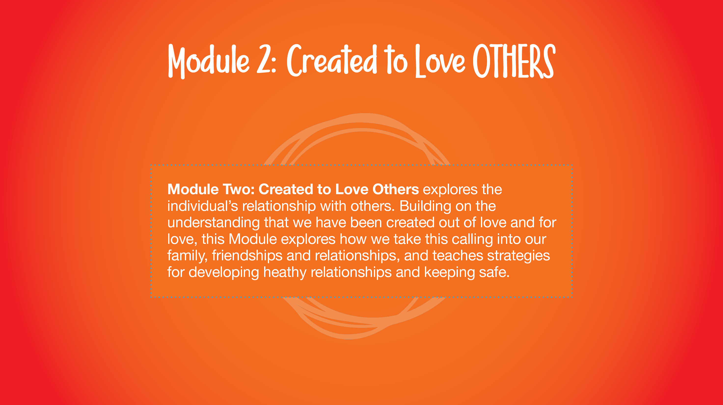
Notes:
Module Two in detail (4 mins)
Slide 13
Module Two: Created to Love Others
Using the text on screen, explain that Module Two: Created to Love Others explores the individual’s relationship with others. Building on the understanding that we have been created out of love and for love, this Module explores how we take this calling into our family, friendships and relationships, and teaches strategies for developing healthy relationships and keeping safe both online and in our daily lives.

Slide 14
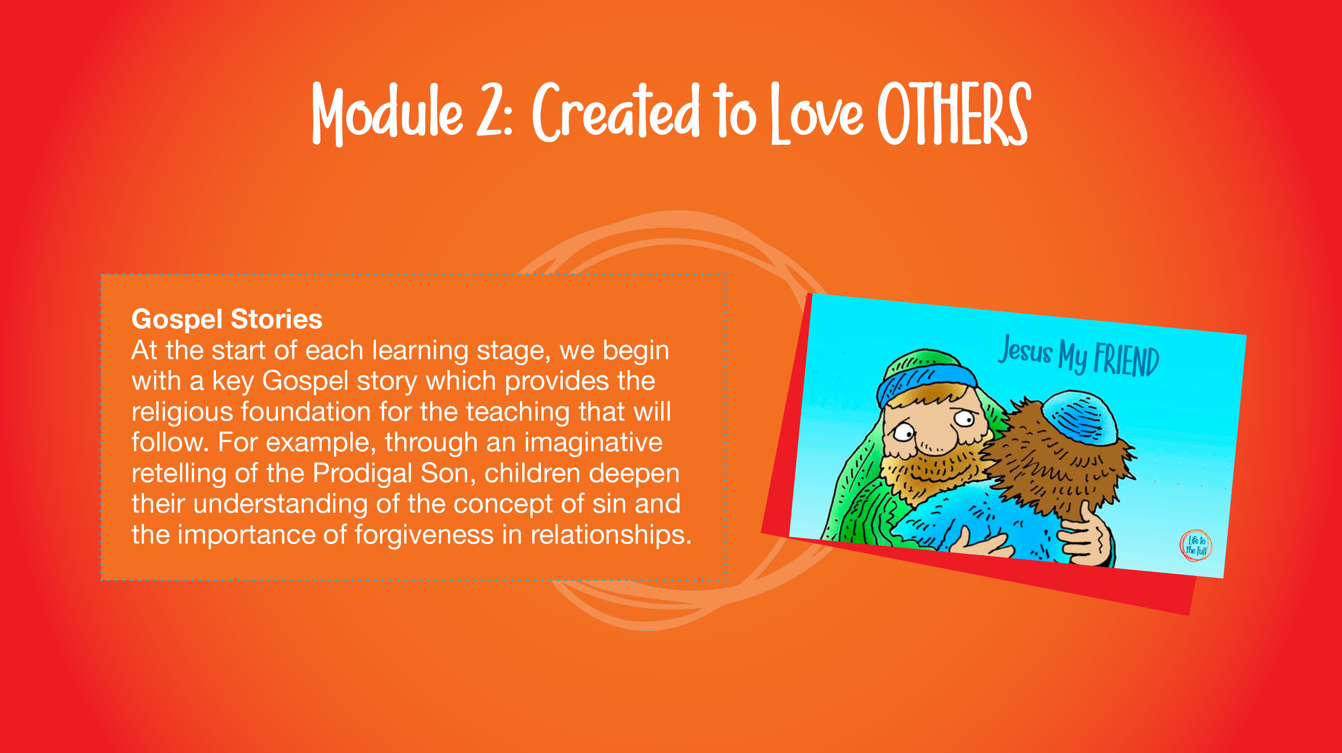
Notes:
Slide 14
At the start of each learning stage, we begin with a series of story sessions based on a key Gospel story which provides the religious foundation for the teaching that will follow. For example, through an imaginative retelling of the Prodigal Son, children deepen their understanding of the concept of sin and the importance of forgiveness in relationships.

Slide 15
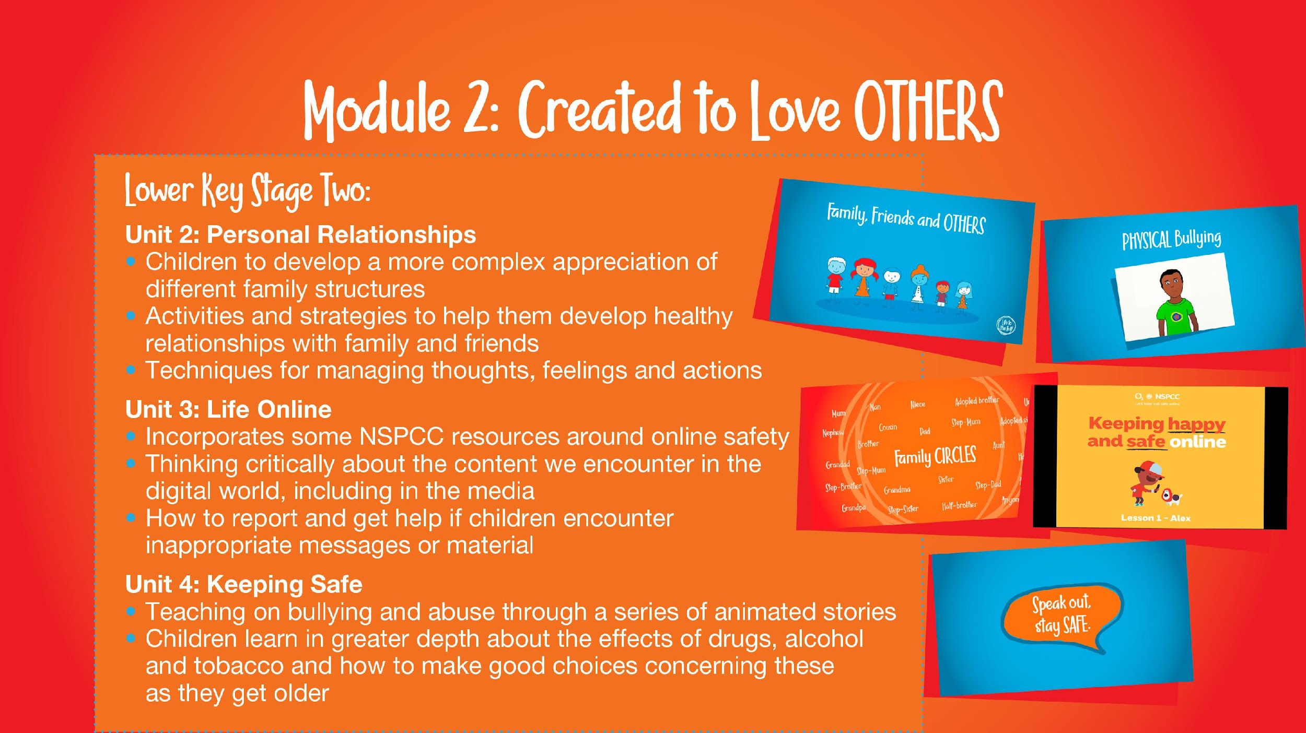
Notes:
Slide 17
Lower Key Stage Two – The Unit 2, ‘Personal Relationships’ sessions help children to develop a more complex appreciation of different family structures and there are activities and strategies to help them develop healthy relationships with family and friends; here, they are also taught simplified CBT techniques for managing thoughts, feelings and actions.
For Unit 3 ‘Life Online’, some NSPCC resources about online safety have been incorporated as part of the programme and children will learn to think critically about what they encounter online and know how to access help if they come across inappropriate material online.
Then in Unit 4 ‘Keeping Safe’, as well as teaching on bullying and abuse through a series of animated stories. Children will also learn in greater depth about the effects of drugs, alcohol and tobacco and how to make good choices concerning these as they get older.

Slide 16
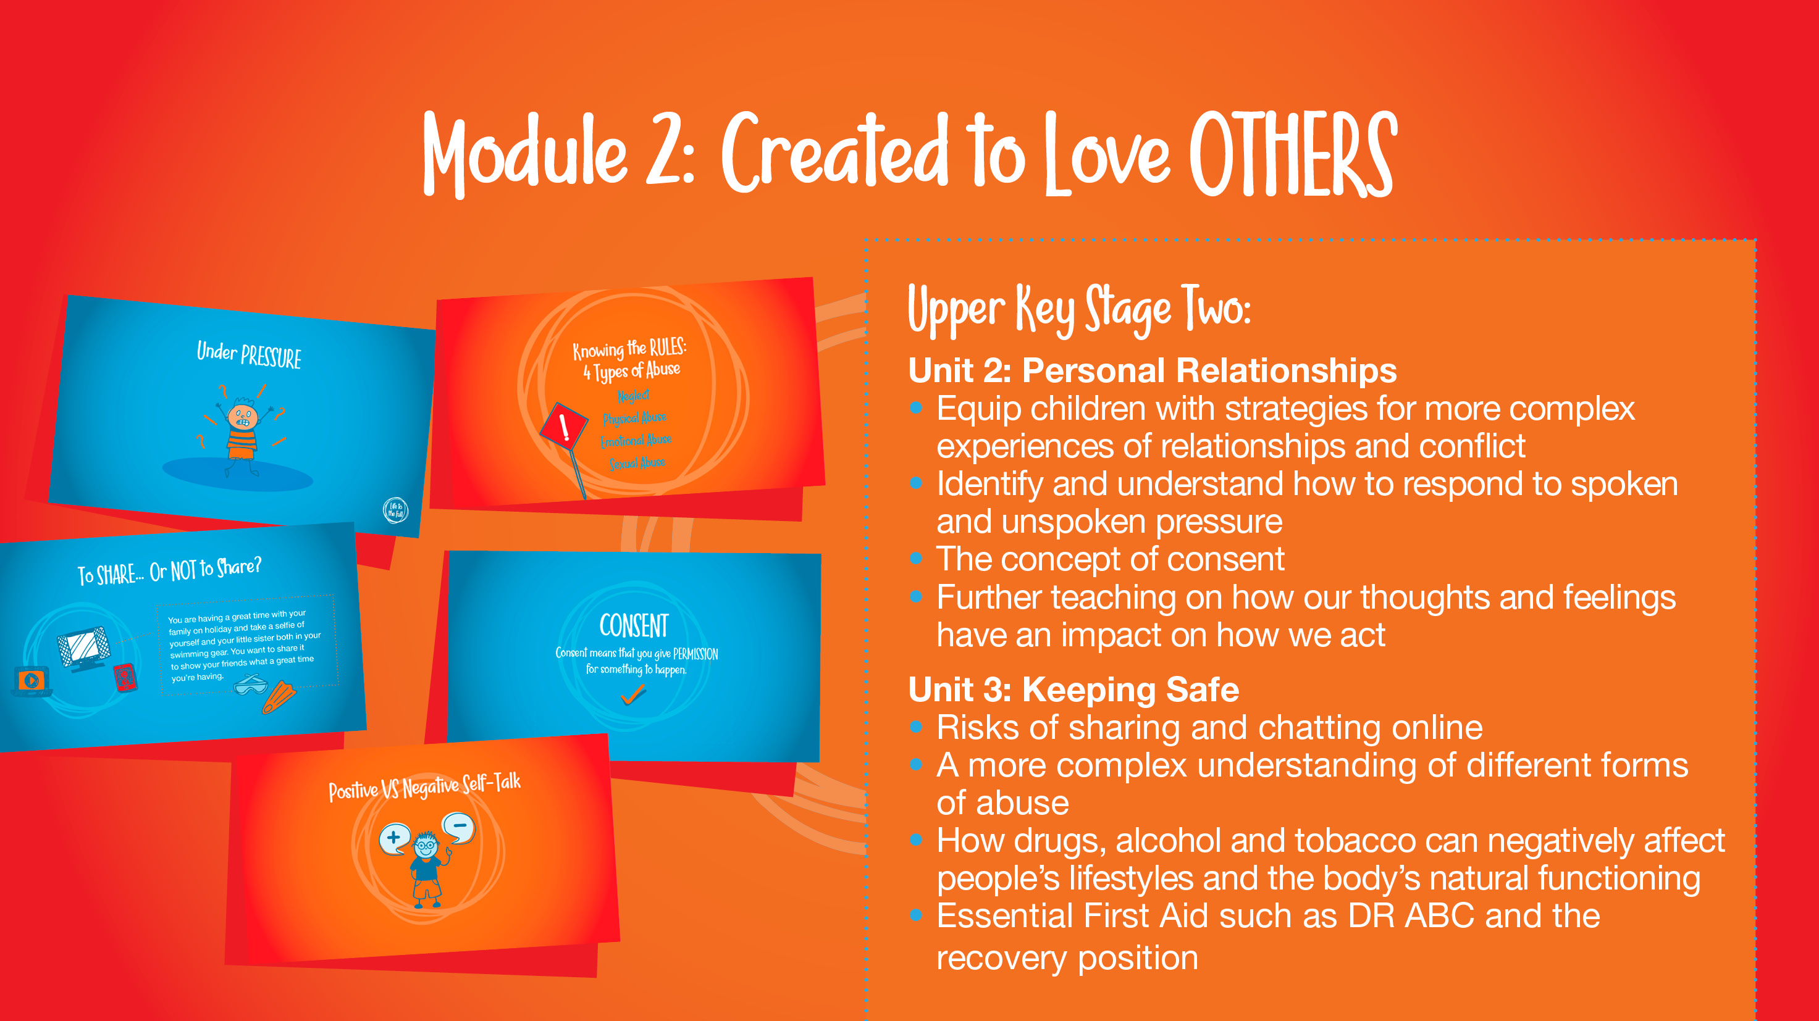
Notes:
Slide 18
Upper Key Stage Two – The sessions for UKS2 in Unit 2 ‘Personal Relationships’ sessions aim to equip children with strategies for more complex experiences of relationships and conflict; this includes sessions that help children to identify and understand how to respond to spoken and unspoken pressure, the concept of consent and some practical demonstrations of this, and further teaching on how our thoughts and feelings have an impact on how we act.
In Unit 3, Life Online, the programme explores the risks of sharing and chatting online at a level more appropriate to Years 5 and 6.
In Unit 4 ‘Keeping Safe’, children gain a more complex understanding of different forms of abuse. They also explore how drugs, alcohol and tobacco can negatively affect people’s lifestyles and the body’s natural functioning, discuss how to make good choices even in pressured situations, and teach essential First Aid such as DR ABC and the recovery position.

Slide 17
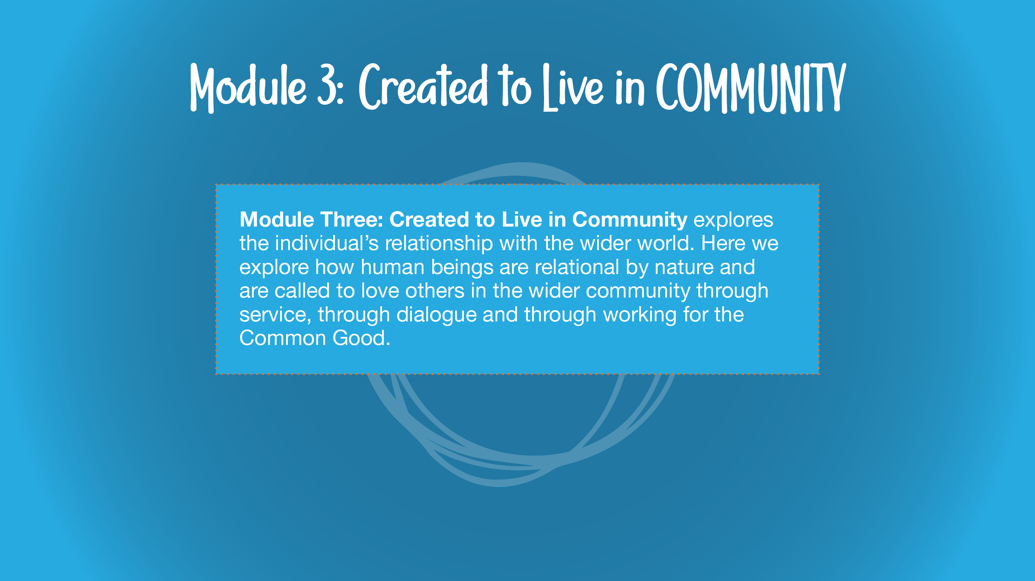
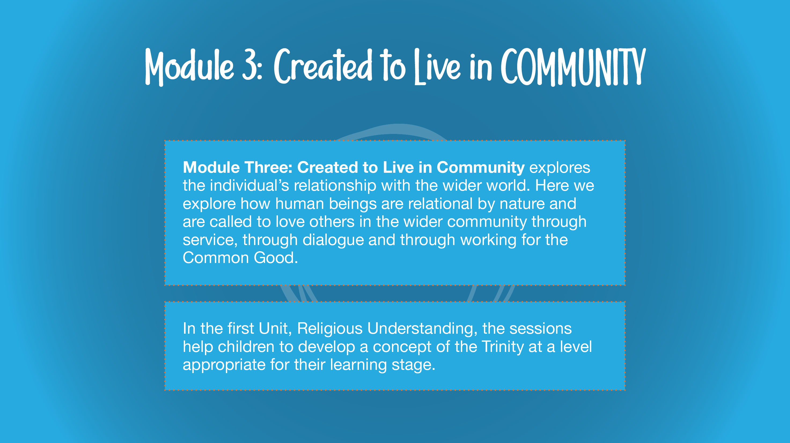
Notes:
Module Three in detail (2 mins)
Slide 20
Module Three: Created to Live in Community
Using the text on screen, explain that Module Three: Created to Live in Community explores the individual’s relationship with the wider world. Here we explore how human beings are relational by nature and are called to love others in the wider community through service, through dialogue and through working for the Common Good.

Slide 18
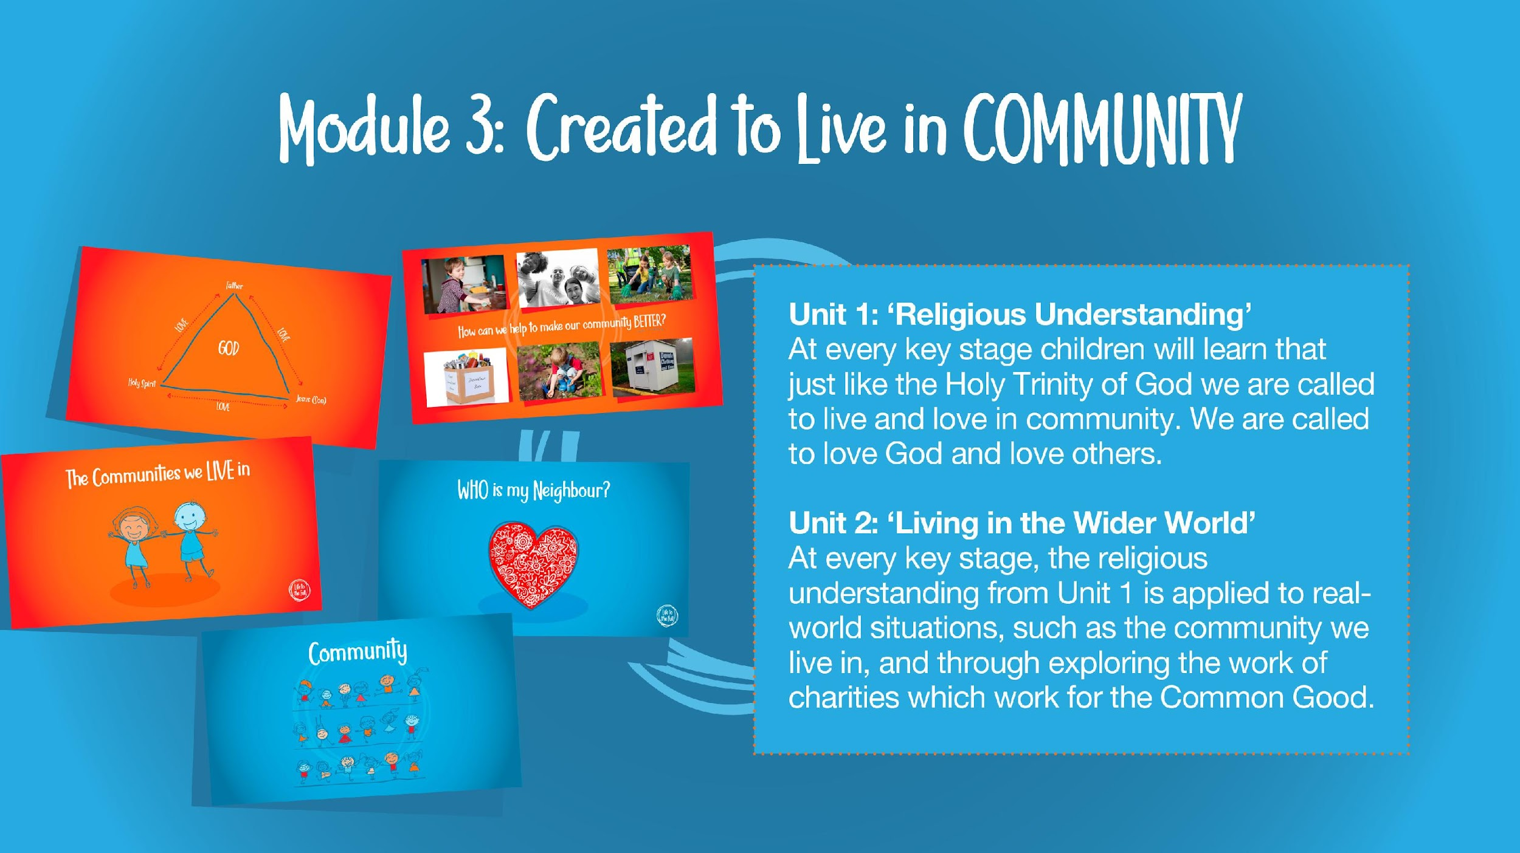
Notes:
Slide 21
In the first Unit, Religious Understanding, the story sessions help children to develop a concept of the Trinity.
Subsequent Sessions for EYFS, KS1, LKS2, UKS2
In subsequent sessions, this religious understanding is applied to real-world situations, such as the community we live in, and through exploring the work of charities which work for the Common Good.

Slide 19


Slide 20

Notes:
Online Parent Portal (4 mins)
Slide 25
Explain to parents that Ten Ten Resource have developed an Online Parent Portal as part of the programme where further information about the programme resources can be accessed, activities for home learning and links to family prayers relating to the programme.
Signpost to parents how they can access the site using the school’s unique username and password.

Slide 21
Overview
Autumn 1 – Module 1 – Unit 1 – A faithful God
  Calming the Storm
Autumn 1 – Module 1 – Unit 2 – A beautiful body
  Gifts and talents
  Girl’s bodies
  Boy’s bodies
  Spots and sleep
Autumn 2 – Module 1 – Unit 3 – This is me
  Body Image
  Peculiar Feelings
  Emotional changes
  Seeing stuff online
Notes:
A Faithful God
Assessment Activity before/after unit
‘Calming the Storm’
5 story sessions taught over 1 week (15+ minutes per session)
Learning Objectives:
•We were created individually by God who cares for us and wants us to put our faith in Him.
• Physically becoming an adult is a natural phase of life.
• Lots of changes will happen during puberty and sometimes it might feel confusing, but it is all part of God’s great plan and the results will be worth it!
My Beautiful Body
Assessment Activity
before/ after unit
Session 1:
Gifts and Talents
(45-60 minutes)
Learning Objectives:
•Similarities and differences between people arise as they grow and mature, and that by living and working together (‘teamwork’) we create community;
•Self-confidence arises from being loved by God (not status, etc).
Session 2:
Girl’s Bodies
(45-60 minutes)
Learning Objectives:
•That human beings are different to other animals;
•About the unique growth and development of humans, and the changes that girls will experience during puberty;
•About the need to respect their bodies as a gift from God to be looked after well, and treated appropriately;
•The need for modesty and appropriate boundaries.
Session 3:
Boy’s Bodies
(45-60 minutes)
Learning Objectives:
•That human beings are different in kind to other animals;
•About the unique growth and development of humans, and the changes that boys will experience during puberty;
•About the need to respect their bodies as a gift from God to be looked after well, and treated appropriately;
•The need for modesty and appropriate boundaries
Session 4: Spots and Sleep
(45-60 minutes)
Learning Objectives:
•How to make good choices that have an impact on their health: rest and sleep, exercise, personal hygiene, avoiding the overuse of electronic entertainment, etc.
This is Me
Assessment Activity before/after
Session 1:
Body Image
(45-60 minutes)
Learning Objectives:
•To recognise that images in the media do not always reflect reality and can affect how people feel about themselves
•That thankfulness builds resilience against feelings of envy, inadequacy, etc. and against pressure from peers or media
Session 2: Peculiar Feelings
(45-60 minutes)
Learning Objectives:
•To deepen their understanding of the range and intensity of their feelings; that ‘feelings’ are not good guides for action.
•That some behaviour is wrong, unacceptable, unhealthy or risky.
Session 3: Emotional Changes
(45-60 minutes)
Learning Objectives:
•Emotions change as they grow up (including hormonal effects);
•To deepen their understanding of the range and intensity of their feelings; that ‘feelings’ are not good guides for action;
•About emotional well-being: that beauty, art, etc. can lift the spirit; and that also openness with trusted parents/carers/teachers when worried ensures healthy well-being.
Session 4:
Seeing Stuff Online
(45-60 minutes)
•The difference between harmful and harmless videos and images;
•The impact that harmful videos and images can have on young minds;
•Ways to combat and deal with viewing harmful videos and images.

Slide 22
Overview
Spring 1 – Module 1 – Unit 4 – Growing up
  Life cycles
  Making babies
Spring 2 – Module 2 – Unit 1 – Talking to God
  Is God calling you?
Spring 2 – Module 2 – Unit 2 – Pete Under Pressure
  Under pressure
  Do you want a piece of cake? (consent and autonomy)
  Self Talk
Notes:
Growing Up
P1 Assessment Activity
Before/after
Y3 and 4 Session 1:
Life Cycles
(40 minutes)
Learning Objectives:
•That they were handmade by God with the help of their parents;
•How a baby grows and develops in its mother’s womb including, scientifically, the uniqueness of the moment of conception;
•How conception and life in the womb fits into the cycle of life;
Session 1:
Making Babies (part one)
Learning Objectives:
• How a baby grows and develops in its mother’s womb.
Session 2:
Making Babies (Part 2)
Learning Objectives:
• Basic scientific facts about sexual intercourse between a man and woman;
• The physical, emotional, moral and spiritual implications of sexual intercourse;
• The Christian viewpoint that sexual intercourse should be saved for marriage.
Talking to God
Assessment Activity before/after
Session1:
Is God Calling You?
The story of Zacchaeus’ Conversion
(50 minutes)
Learning Objectives:
•To know that God calls us to love others.
•To know ways in which we can participate in God’s call to us.
Pete Under Pressure
Assessment Activity before/after
Session 1:
Under Pressure
(45 minutes)
Learning Objectives:
•Pressure comes in different forms, and what those different forms are;
•There are strategies that they can adopt to resist pressure.
Session 2:
Do You Want a Piece of Cake?
(45 minutes)
Learning Objectives:
•Understand what consent and bodily autonomy means;
•Discuss and reflect on different scenarios in which it is right to say ‘no’.
Session 3:
Self-Talk
(45 minutes)
Learning Objectives:
•Learn about how thoughts and feelings impact on actions, and develop strategies that will positively impact their actions;
•Apply this approach to personal friendships and relationships.

Slide 23
Overview
Summer 1 – Module 2 – Unit 3 – Dear Diary
  Sharing isn’t always caring
  Cyber bullying
  Types of Abuse
  Impacted Lifestyles
  Making Good Choices
  Giving Assistance
Summer 2 – Module 3 – Unit 1 – Loving our neighbour
  The Trinity
  Catholic Social teaching
Summer 2 – Module 3 – Unit 2 – Created to Live in Community
  Reaching out
Notes:
Dear Diary
Assessment Activity before/after
Session 1:
Sharing Isn’t Always Caring
(45 minutes)
Learning Objectives:
•To recognise that their increasing independence brings increased responsibility to keep themselves and others safe.
•How to use technology safely.
•That just as what we eat can make us healthy or make us ill, so what we watch, hear, say or do can be good or bad for us and others.
•How to report and get help if they encounter inappropriate materials or messages.
Session 2:
Cyberbullying
(45 minutes)
Learning Objectives:
•What the term cyberbullying means and examples of it;
•What cyberbullying feels like for the victim;
•How to get help if they experience cyberbullying.
Session 3:
Types of Abuse
(45 minutes)
•To judge well what kind of physical contact is acceptable or unacceptable and how to respond.
•That there are different people we can trust for help, especially those closest to us who care for us, including parents, teachers and priests
Session 4:
Impacted Lifestyles
(45 minutes)
Learning Objectives:
•Understand the effect that a range of substances including drugs, tobacco and alcohol can have on the body.
• Learn how to make good choices about substances that will have a positive impact on their health.
• Know that our bodies are created by God, so we should take care of them and be careful about what we consume.
Session 5:
Making Good Choices
(45 minutes)
Learning Objectives:
• Recognise how they may come under pressure when it comes to drugs, alcohol and tobacco
• Learn that they are entitled to say “no” for all sorts of reasons, but not least in order to protect their God-given bodies
Session 6:
Giving Assistance
(45 minutes)
Learning Objectives:
• The recovery position can be used when a person is unconscious but breathing.
• DR ABC is a primary survey to find out how to treat life-threatening conditions in order of importance.
Loving Our Neighbour
Assessment Activity before/after
Session 1:
The Trinity
(50 minutes)
Learning Objectives:
•To know that God the Father, God the Son and God the Holy Spirit make up the three persons of the Trinity.
• To know that the Holy Spirit works through us to bring God’s love and goodness to others.
Session 2:
Catholic Social Teaching
(50 minutes)
Learning Objectives:
The principles of Catholic Social Teaching
• That God formed them out of love, to know and share His love with others.
Created to Live in Community
Assessment Activity before/after
Session 1:
Reaching Out
(15 minutes)
Learning Objectives:
• Learn to apply the principles of Catholic Social Teaching to current issues
• Find ways in which they can spread God’s love in their community

Slide 24
Questions
Prior to sessions being delivered, we will send home messages as reminders of any sensitive content we will be covering so you’re prepared for any questions or discussions at home and the discussions that will be taking place in school within the classroom and amongst peers.
Do send us a message should you have any questions or concerns and we can arrange a meeting to discuss this.

Slide 25
Y6 parents
Please complete the survey by Friday 27th September 2024 to confirm you’ve attended the briefing at school or watched the video, as well to give consent for your child to access the Sex Education element of the curriculum, which you do have the right to withdraw your child. https://forms.office.com/Pages/ResponsePage.aspx?id=OFYclXnjhUaRUhyDCcoxaVMaSnII62tCnd7VLks7qWlUQlY4TlA1MkVLN082STJZSEJVTk9PTks4QS4u
Thank you
Miss Fisher

Slide 27
